Slide 1
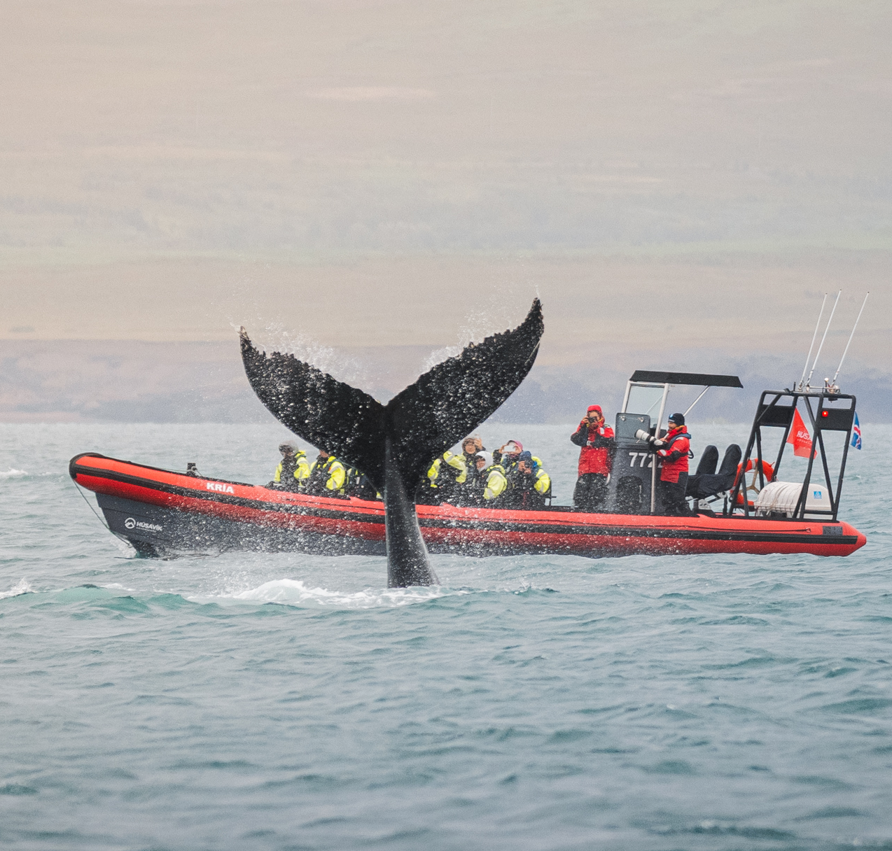
Italy
Iceland
Scotland
Greece
GENERAL BOOKING WINDOW
March 17 – 24, 2025
TRAVEL WINDOW
May 01, 2025 – April 30, 2026
*Restrictions Apply
Notes:
*Offer valid on new retail bookings only made 03/17/2025 – 03/24/2025 for travel 05/01/2025 – 04/30/2026. Offer code EUROPE25 must be used at time of booking for savings. Offer applies to land package only and does not apply to any other required supplements or internal air. Payment in full required by 4/15/2025. Offers can expire earlier due to space or inventory availability. Space is on a first come, first served basis. Offer is not valid on group or existing bookings. Offers are combinable with member benefits only. This offer is not combinable with any other offers. Availability varies by destination and month of travel. Other restrictions may apply.

